Slide 1
The Walt Disney Company
First Quarter Fiscal 2026 Earnings
Quarter Ended December 27, 2025

Slide 2
Quarter at a Glance
Revenue
Diluted EPS
$26.0B
$1.34
+5% YoY
-4% YoY
Total Segment OI
Adjusted EPS
$4.6B
$1.63
-9% YoY
-7% YoY

Slide 3
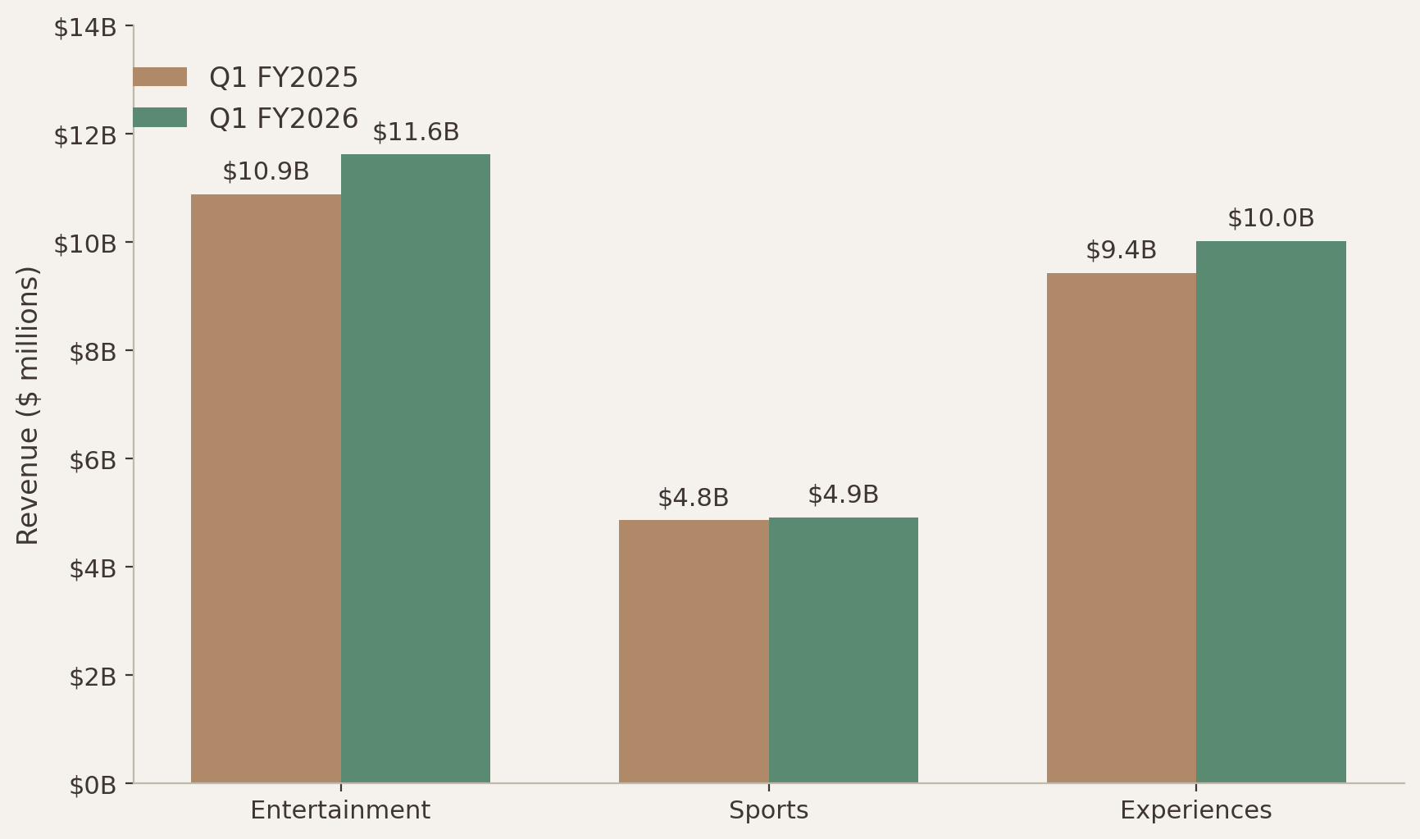
Revenue by Segment
Total revenues increased 5% to $26.0 billion

Slide 4
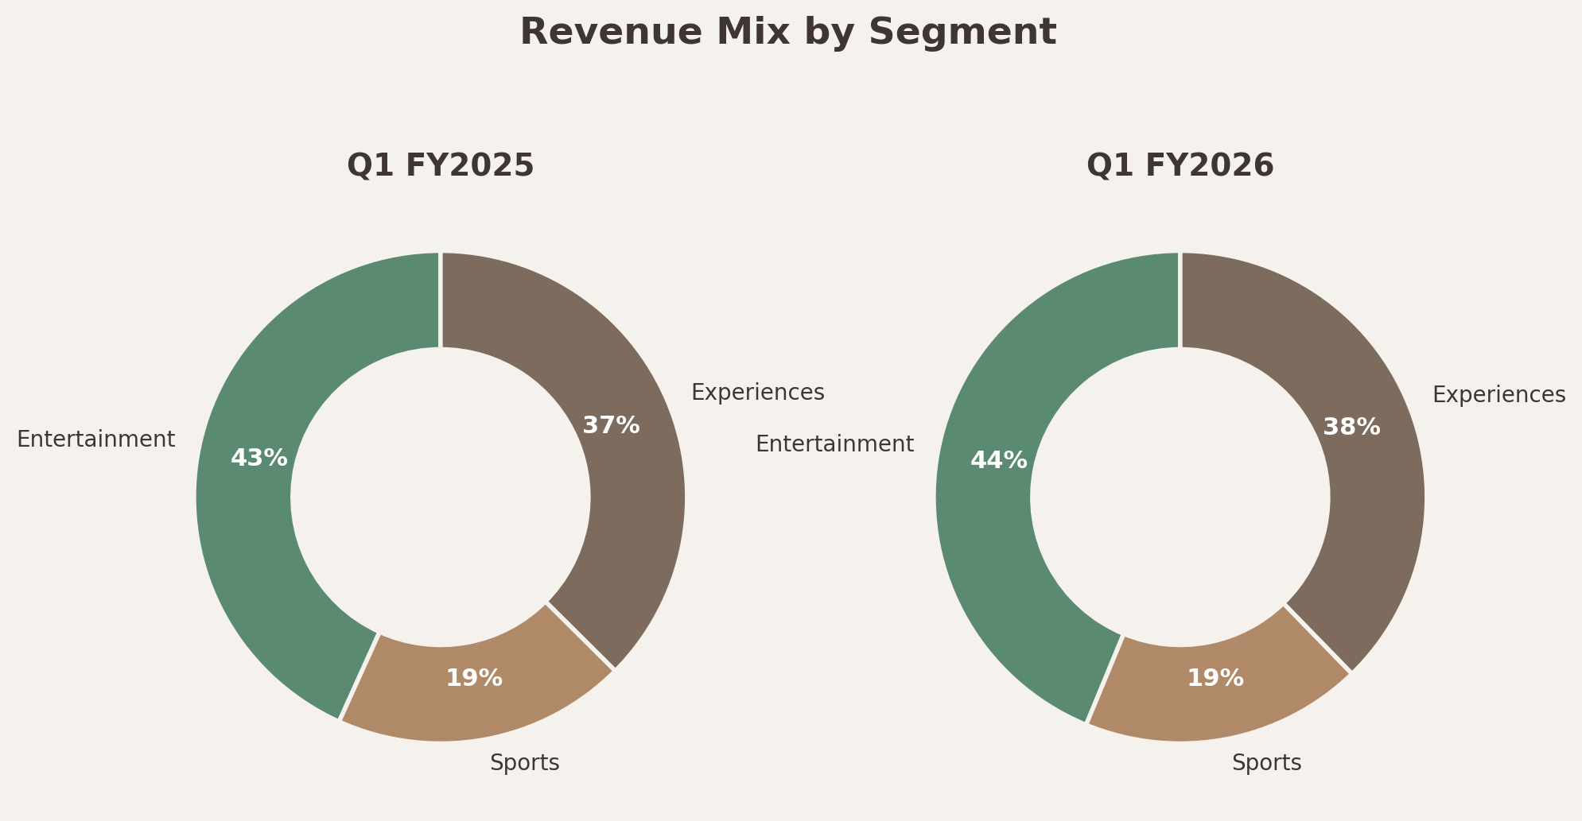
Revenue Mix Evolution
Experiences now represents 38% of total revenue

Slide 5
01
Entertainment Segment
Revenue up 7%, OI down 35%

Slide 6
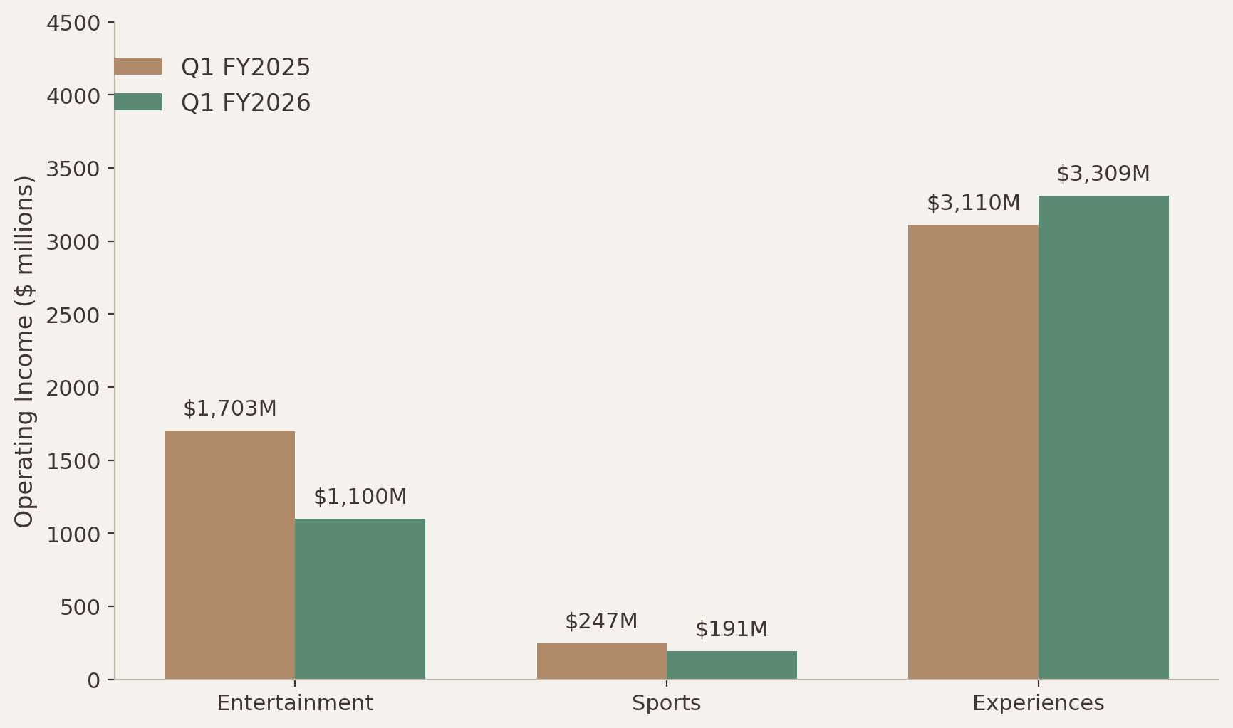
Entertainment Performance
Revenue
$11.6B (+7% YoY)
Operating Income
$1.1B (-35% YoY)
Key Drivers:
Strong theatrical releases
SVOD profitability improvement
Content investment normalization

Slide 7
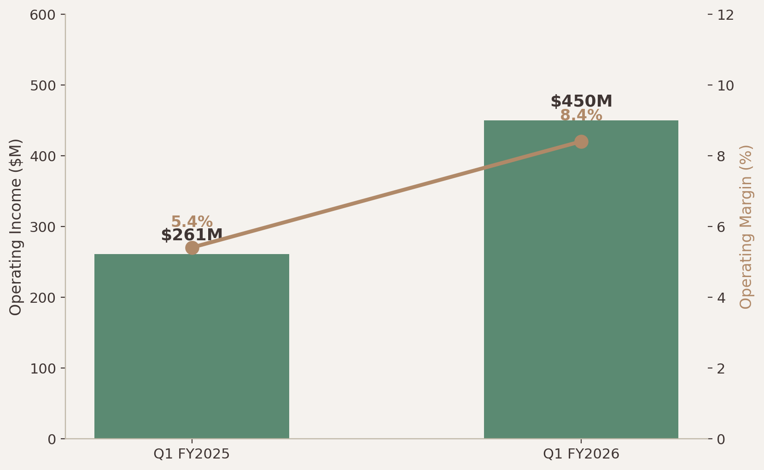
SVOD Profitability
SVOD Operating Income
SVOD Operating Margin
$450M
8.4%
+72% YoY
↑ Strong growth

Slide 8
02
Experiences Segment
Record Revenue of $10.0B

Slide 9
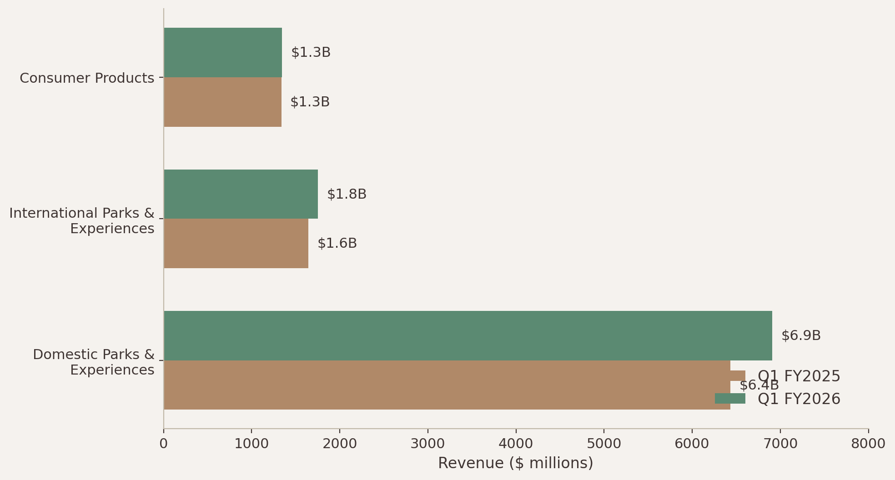
Experiences Segment
Record Quarterly Revenue
$10.0B
Operating Income
$3.3B (+6% YoY)

Slide 10
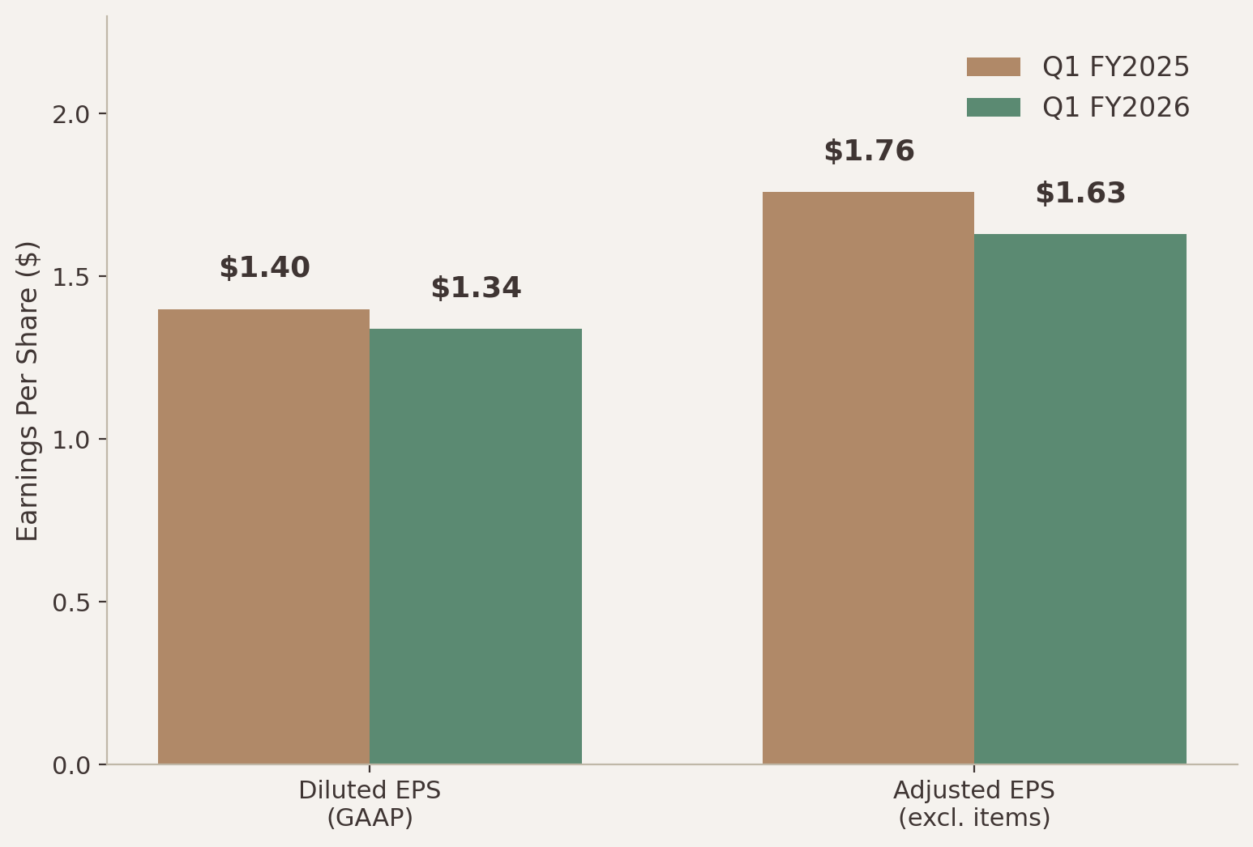
Profitability Metrics
Adjusted EPS: $1.63 (-7% YoY)
Diluted EPS: $1.34 (-4% YoY)
Significant items impacted reported earnings

Slide 11
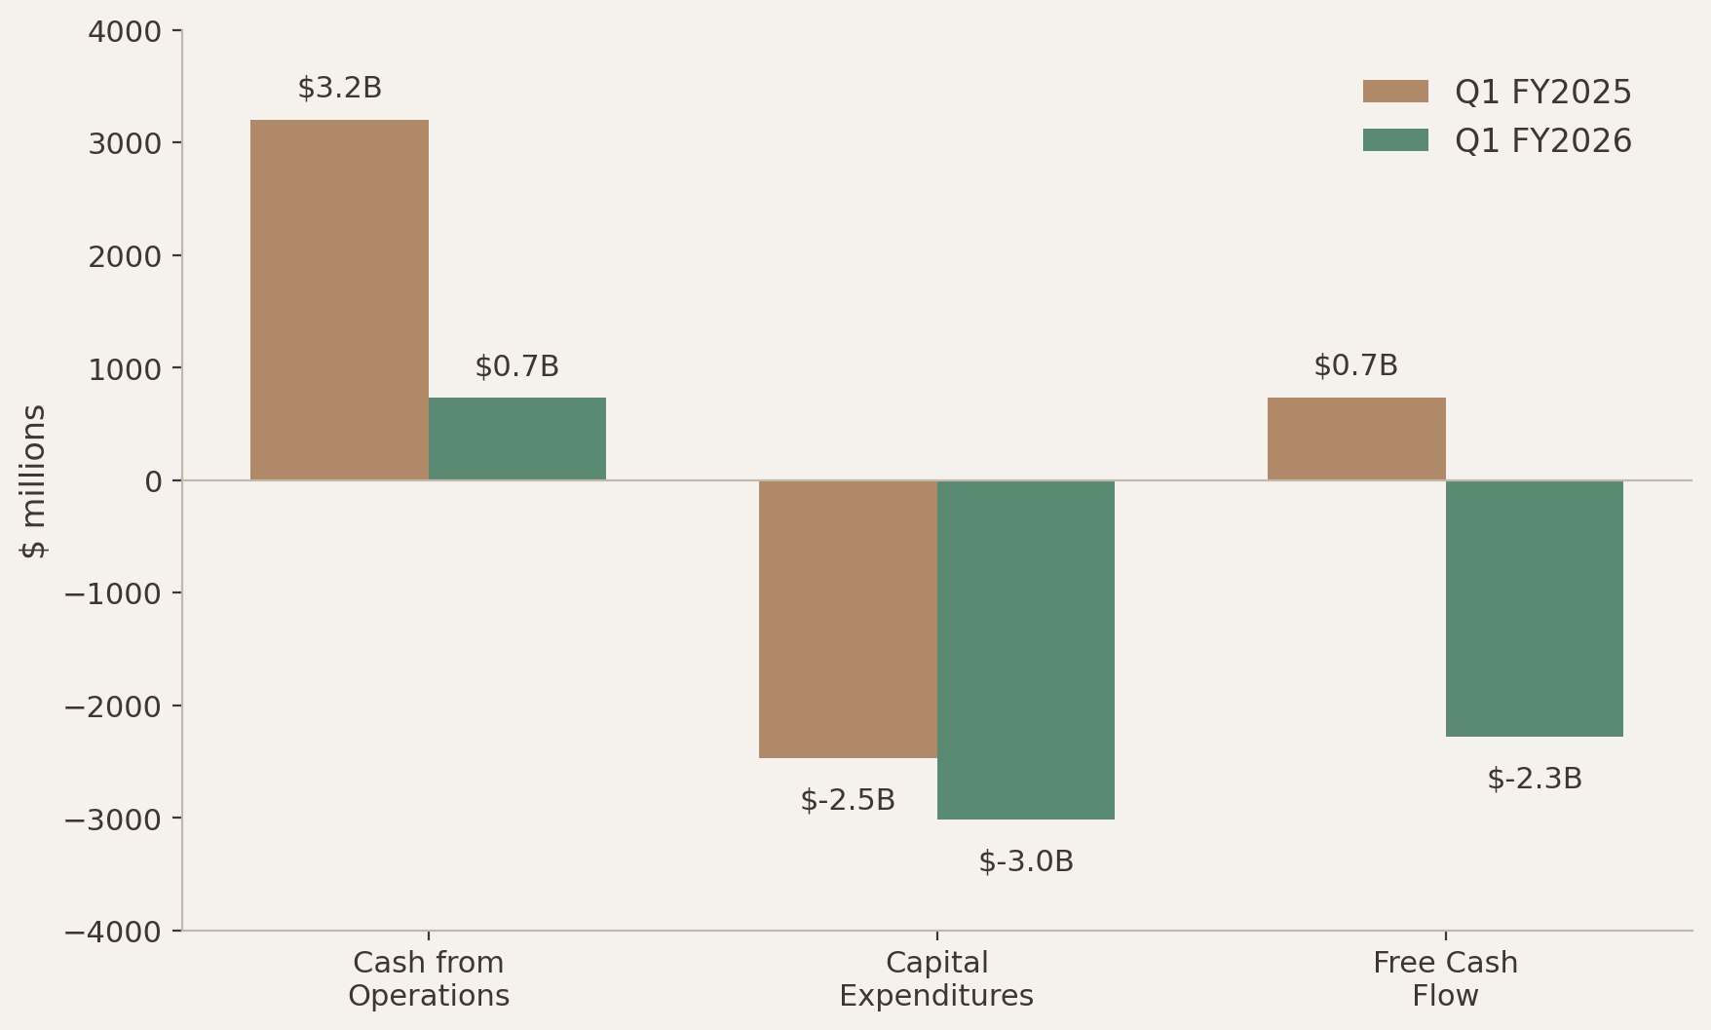
Cash Flow & CapEx
Total CapEx: $3.0B
Share Repurchases: $2.0B

Slide 12
FY2026 Outlook
Double digit adjusted EPS growth
SVOD operating margin target: 10%
$19B cash from operations
$7B stock repurchase target
High-single digit Experiences OI growth

